Slide 1
Presented by
Joy Pal - 201002418
Shourav Podder - 202002048

Slide 2
Database System Lab
(CSE 210)
Grocery Park

Slide 3
Contents
01
OBJECTIVES
02
ER-DIAGRAM
03
ANALYSIS OF OUTPUTS
04
CONCLUSIONS

Slide 4
Objectives
Manage the details of Stock, Payments, Sales, Products.
Goals
To automate its existing manual system by the help of computerized equipment and full-fledged computer software.
4

Slide 5



Components
XAMPP
an abbreviation for cross-platform, Apache, MySQL, PHP and Perl, and it allows you to build WordPress site offline, on a local web server on your computer.
MySQL
MySQL is an open-source relational database management system.

Slide 6
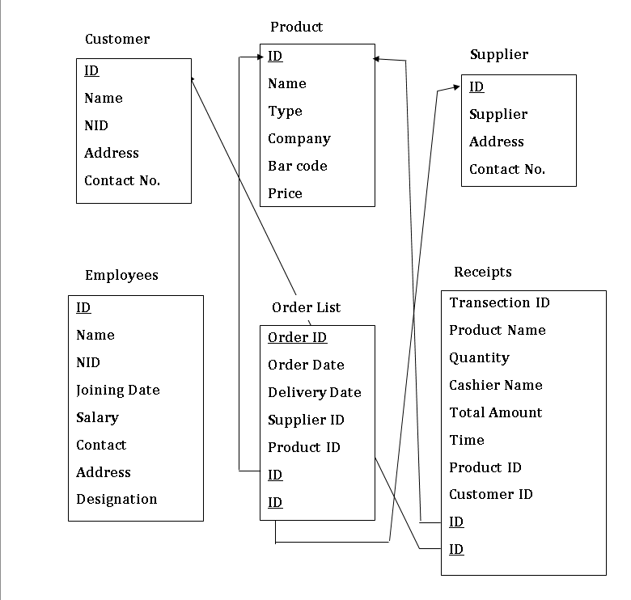
Entity Relations

Slide 7
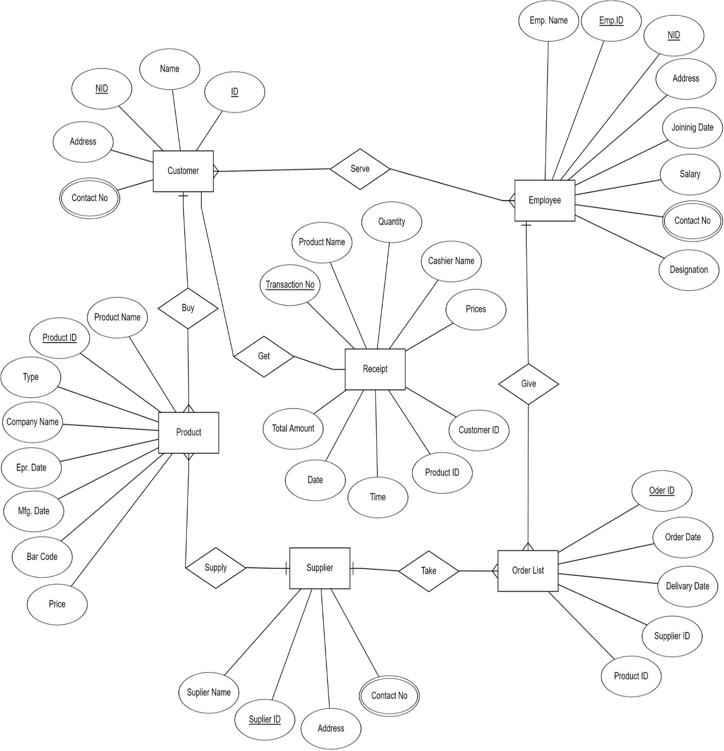
Entity Relations (Cont’d)

Slide 8
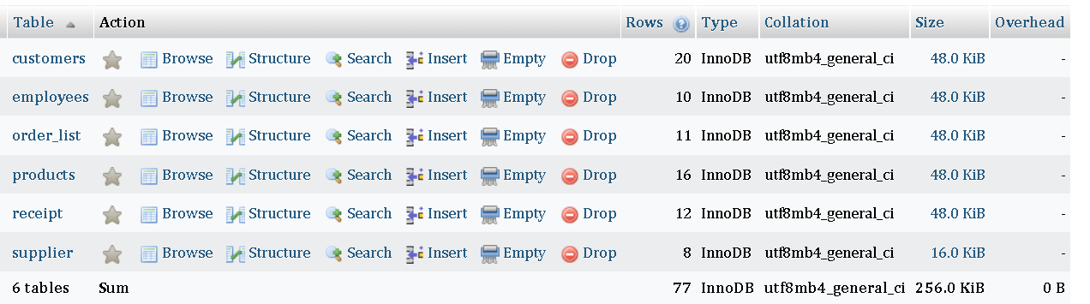
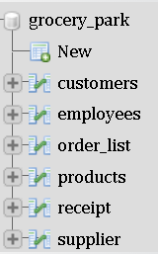
Tables

Slide 9
Key Constraint
Entities | Attribute
Customers | Name, ID, NID, Address, Contact no
Employees | Name, ID, NID, Joining Date, Salary, Contact no, Address, designation
Products | Name, ID, type, company Name, Bar code, price
Receipt | Transaction no, Products name, Quantity, Cashier Name, Total Amount ,date, product id, customer id
Suppliers | Supplier name, ID, Address, Contact no
Order List | Order ID, Order Date, Delivery Date, Supplier ID, Product ID

Slide 10
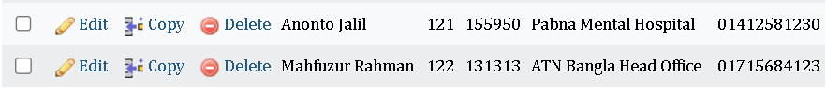
Query
Add 2 new customer information in the customer table
INSERT INTO customers( name, id, nid, address, contact_no)
VALUES( 'Anonto Jalil', '121', '155950', 'Pabna Mental Hospital', '01412581230'),
('Mahfuzur Rahman', '122', '131313', 'ATN Bangla Head Office', '01715684123');

Slide 11
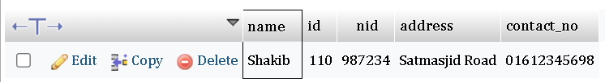
Query ( cont’d )
Display a customer full information from customer table
SELECT *
FROM customers
WHERE name LIKE '%Shakib%';

Slide 12
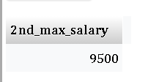
Query ( cont’d )
Find the 2nd maximum salary from employee table
SELECT MAX(salary)AS 2nd_max_salary
FROM employees
WHERE salary < (SELECT MAX(salary) FROM employees);

Slide 13
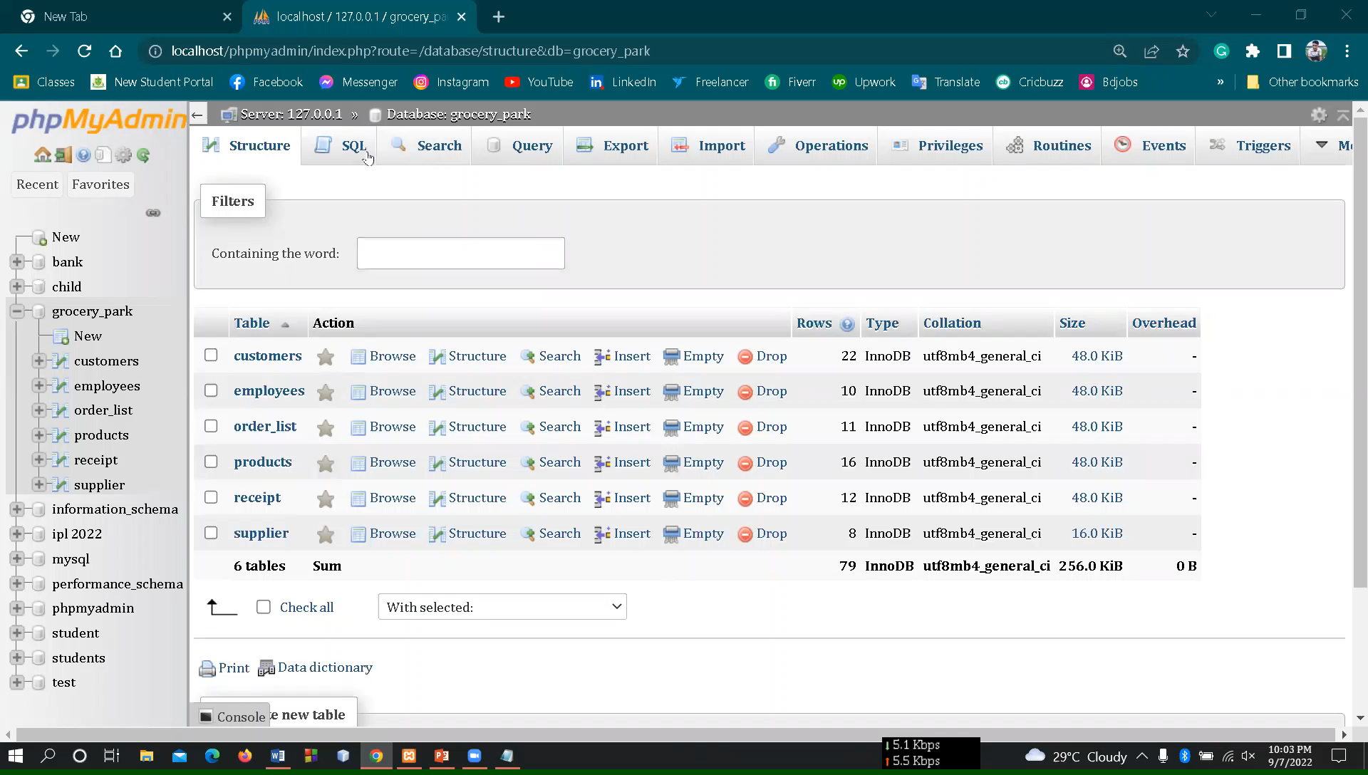
Query ( cont’d )

Slide 14
Thanks!

